Slide 1

Pixel Art Version Peformance
6th Grade
Tutorial performance between 2 versions
Decision to 100% roll out new version
Ideas to improve user performance
Predictive models for user retention
Author: Minh Nguyen

Slide 2
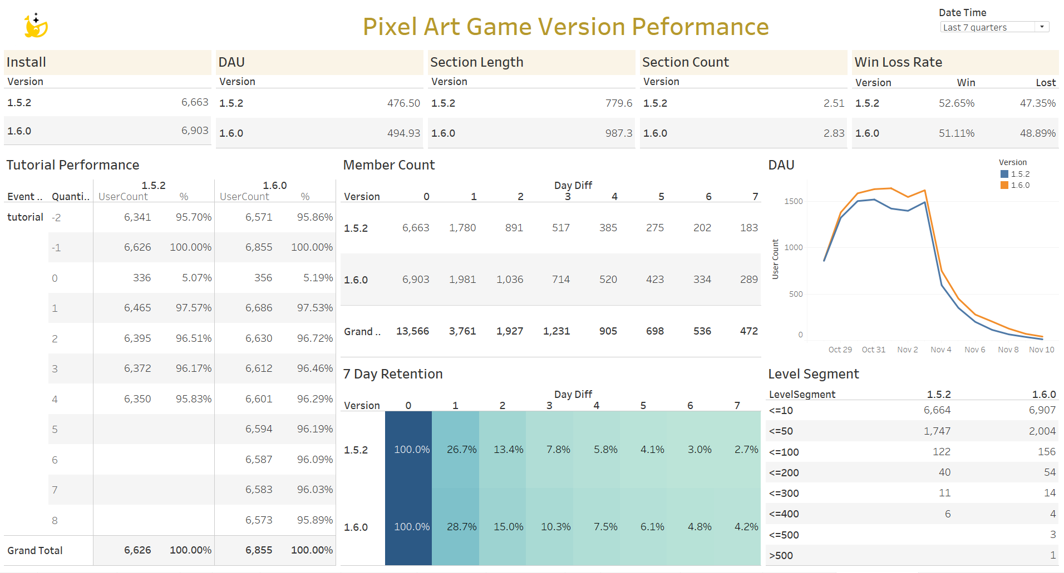
Dashboard overview

Slide 3
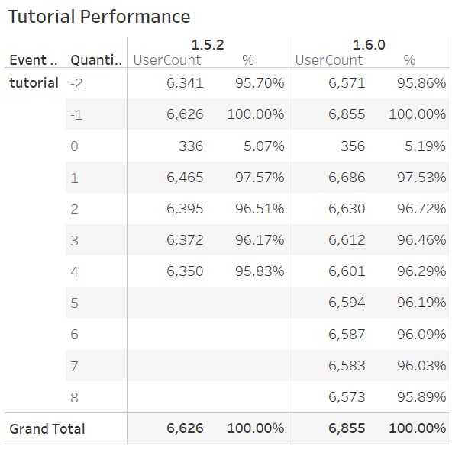
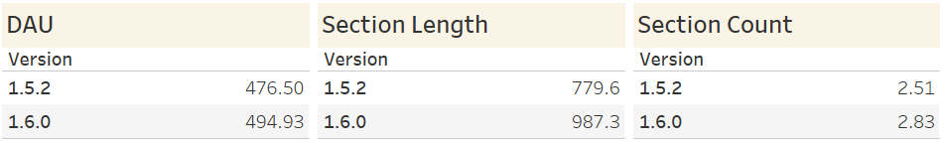
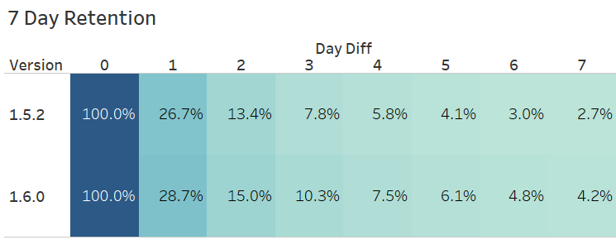
Tutorial performance
The higher Daily Active User, Section Length and Section Count in version 1.6.0 suggests that users are spending more time in the game.
Version 1.6.0 shows a slightly better completion rate
The higher retention rates in version 1.6.0 suggest that users more likely to return and continue playing after their initial session.
Conclusion: Version 1.6.0 has impacted the user experience better than version 1.5.2

Slide 4

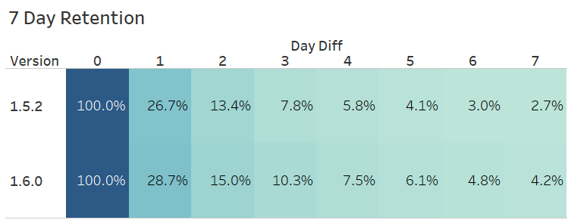
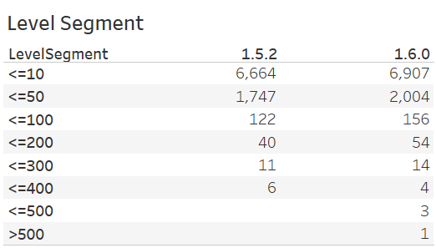
New version roll out 100%
Install: new version is slightly higher => no impact in user acquisition when change to the new version.
DAU: both versions show similar trends => the transition to new version is not negatively affecting overall DAU
Section length: new version is higher (16.45mins) compare to old version (12.99mins) => users spend more time
Section count: new version is higher => users are more engaged
Win rate: new version is marginally lower, this could be related to new players learning the game =>does not affect engagement or retention.
Tutorial completion rate: version 1.6.0 slightly outperforming version 1.5.2 => users are engaging well with the new tutorial
7-day retention: version 1.6.0 are consistently better than version 1.5.2 => strong indicator of improved long-term player satisfaction
Level segment: more users achieve higher levels with the new version => the new tutorial may help users to understand the game better
Conclusion: It seems safe to roll out 100% the new version based on the above performance

Slide 5
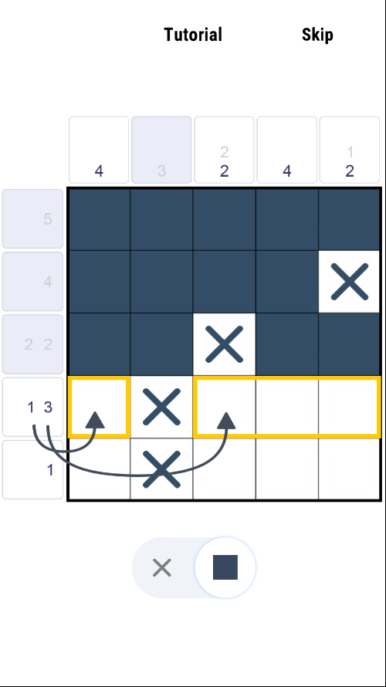
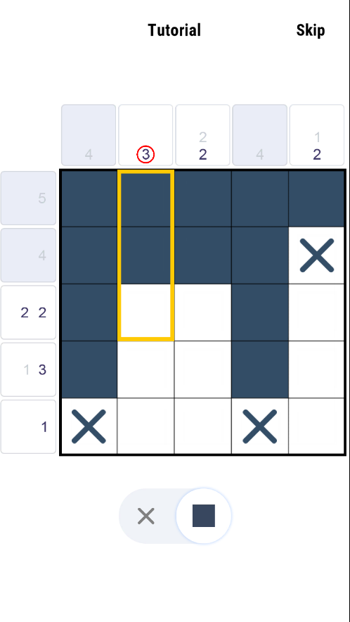
Ideas to improve user performance
Adding hints/tips in the tutorial: if a player struggles to complete the tutorial steps within a certain time limit, additional hints as textual guides could appear, guiding them to the right action.
Incentive to complete the tutorial: Reward more lives or hints if users complete the tutorial. Show progress (ex: "Step 3 of 5") to give users a sense of accomplishment as they move through the tutorial.
Reconfirm the skip option: if new users choose to skip the tutorial, a pop-up message could say, “Are you sure? Completing the tutorial will give you bonus rewards!”
In-game feedback: when a user makes a mistake or delays in completing a step, can show feedback like flashing the correct square in yellow or display a tooltip that says, “Try here!” or “Next step!” to guide users without being overly directive.
Tutorial revisit: Based on how well or poorly users perform in the first few levels, the game could offer users to revisit specific tutorial steps. This would ensure that users who might have skipped or rushed through the tutorial still get the necessary guidance later on.
Version 1.5.2
Version 1.6.0

Slide 6
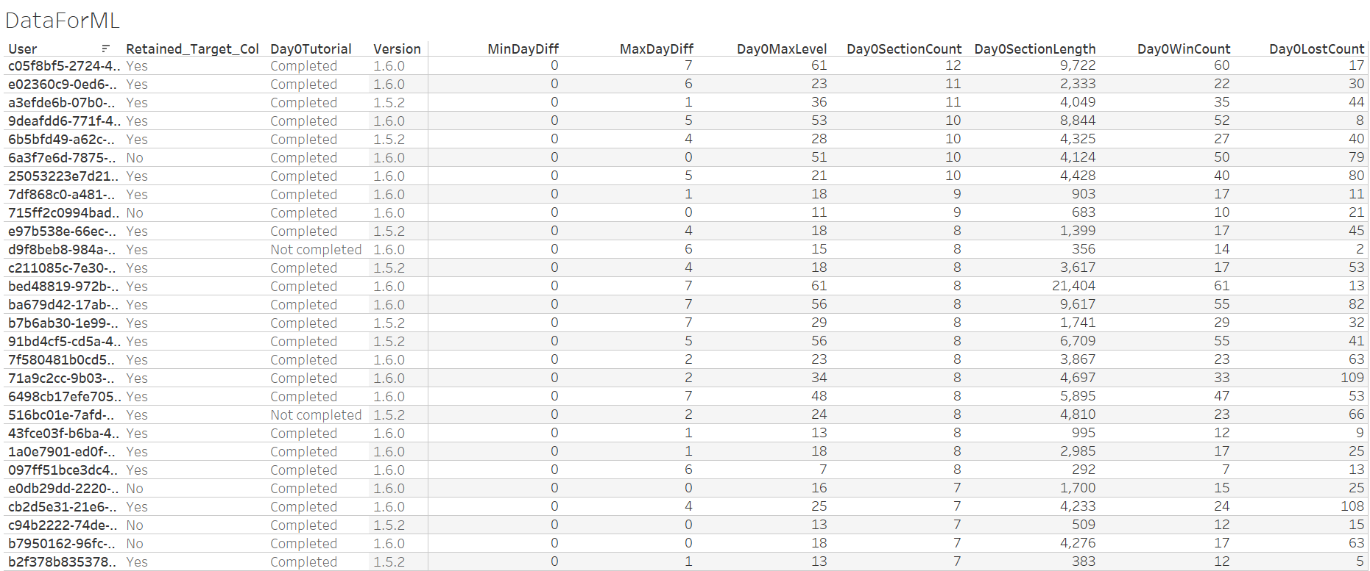
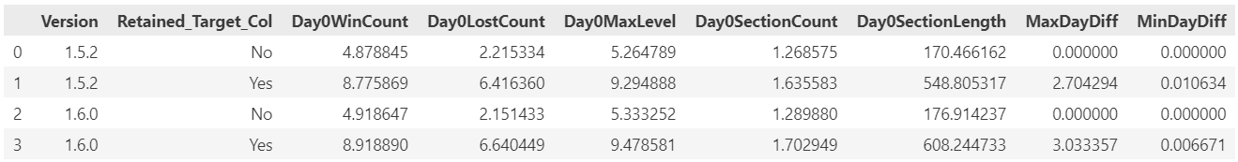
Predict Member Retention Using Classification Models
Exclude DayDiff, other features and version seems to have impact on member retention

Slide 7
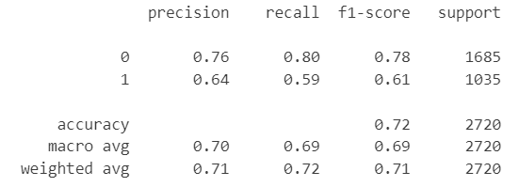
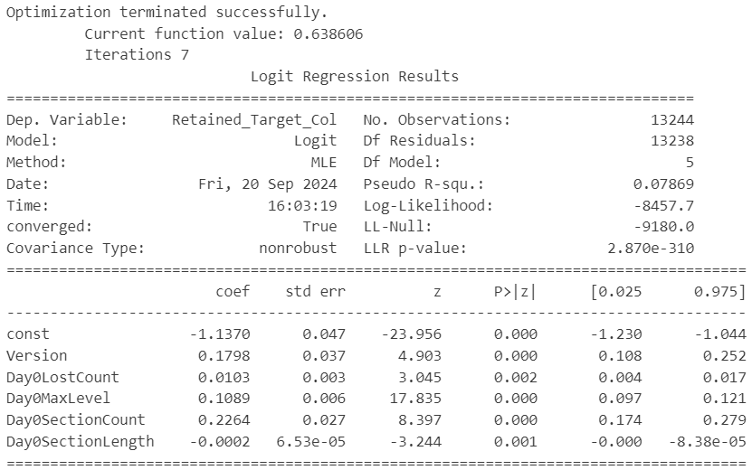
Predict Member Retention Using Classification Models
Overall accuracy is 72%, means that in 72% of cases, the model correctly classified the retention status.
Recall class 0 is 80%, means that 80% of the actual non-retained players were correctly identified by the model.
Precision class 0 is 76%, means that when the model predicted "not retained," it was correct 76% of the time.
Version, LostCount, MaxLevel, SectionCount, SectionLength at day 0 of the members are all important predictors of retention (p-value <0.05)
The R-squared value is low (0.07869), means that the model explains about 7.87% of the variation in the dependent variable. While the predictors are statistically significant, there is still a lot of unexplained variance in retention, and additional factors or additional data for longer period may be needed to improve the model's performance.

Slide 8
Thank you!

